Slide 1
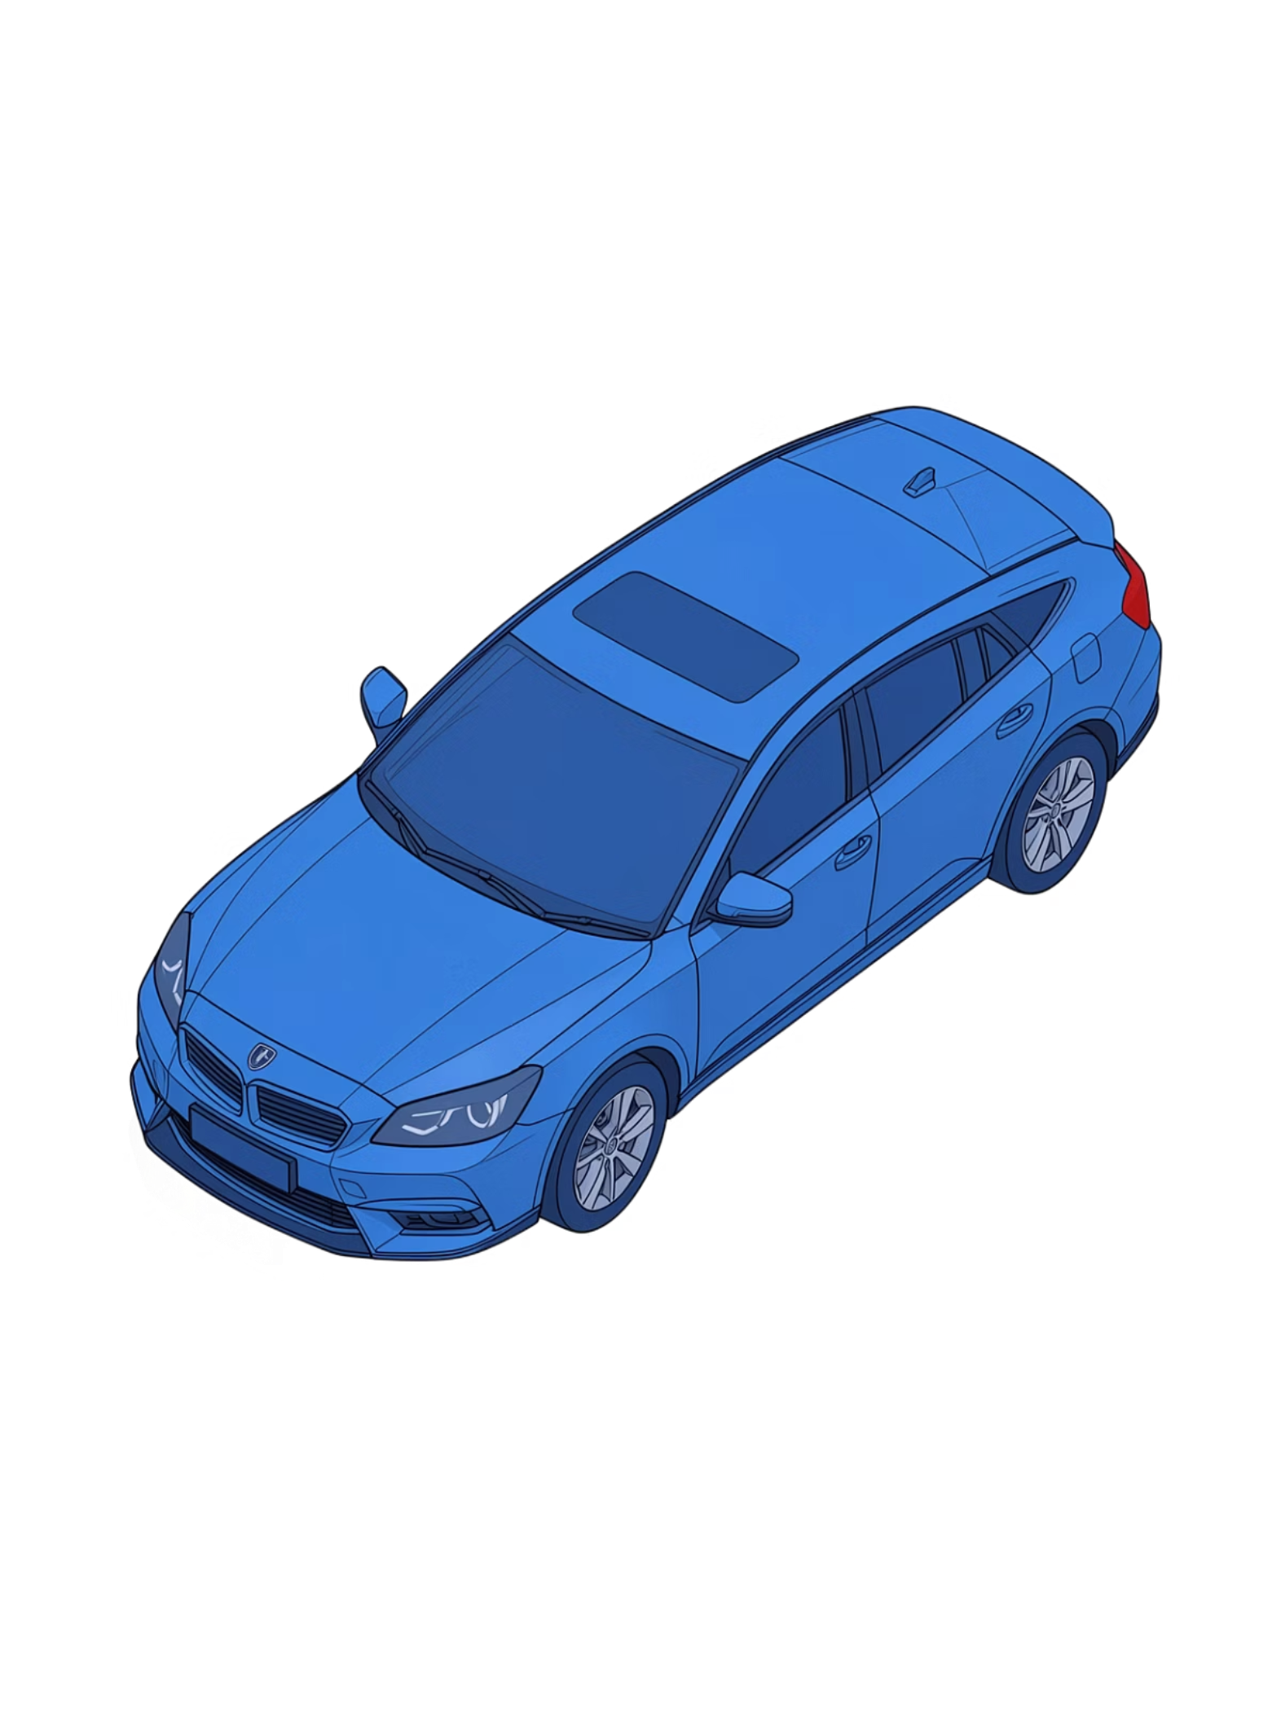
Car Background Removal
Automated car segmentation using Classical and Deep Learning approaches — from complex scenes to clean, transparent outputs.
Supervised By
Team Members
Hind Adel
Ahmed Hamdy · 230103760
Abdo Fouda · 230104495
Alaa Adel · 230105740

Slide 2
Table of Contents
01
02
03
Project Overview & Objectives
Dataset & Preprocessing
Methodology — Deep Learning (U-Net)
Goals, use cases, and core objectives of the system
Data sourcing, augmentation, and split strategy
Architecture design and training strategy
04
05
U-Net Architecture & Training
Results & Evaluation
Encoder-decoder structure, hyperparameters, and optimization
Dice score, IoU metrics, and visual output quality

Slide 3
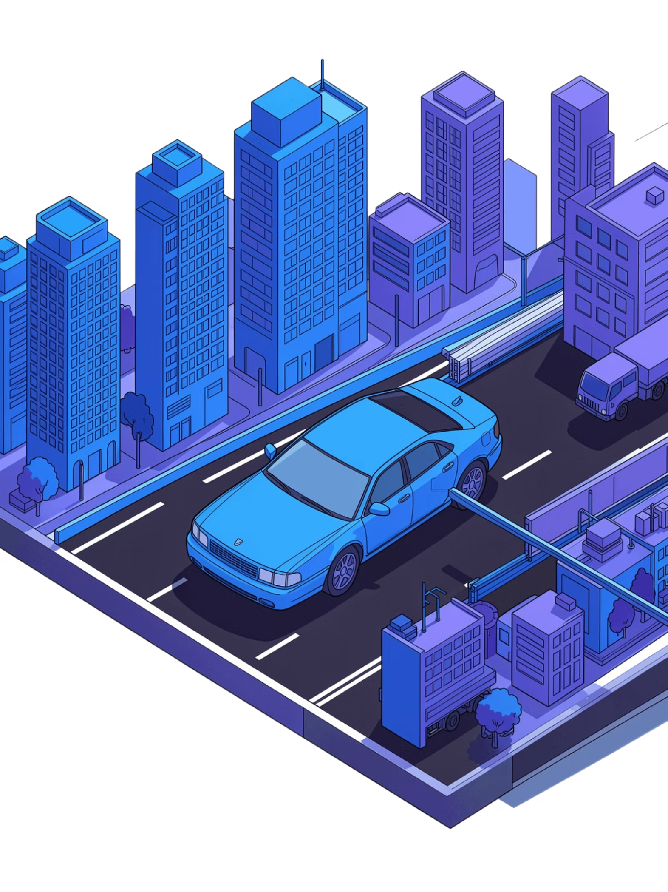
INTRODUCTION
Why Car Background Removal?
In computer vision, isolating a vehicle from its background is a deceptively complex challenge — varying lighting, partial occlusions, reflective surfaces, and intricate edges all conspire against clean segmentation. This project tackles that challenge head-on, comparing classical and deep learning methods to produce pixel-accurate, production-ready transparent car images.

Slide 4
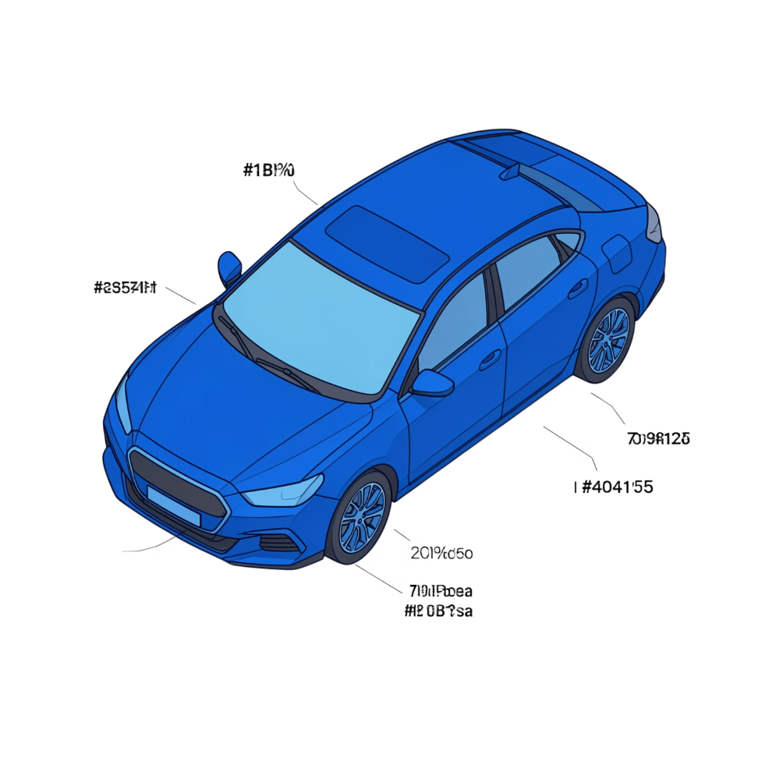
PROJECT OVERVIEW
Project Overview & Objectives
Core Goal
Automatically detect and segment cars from complex real-world backgrounds, preserving fine structural details — edges, wheels, windows — and exporting clean transparent PNGs.
Key Objectives
Accurately segment cars across diverse backgrounds and lighting conditions
Benchmark GrabCut (Classical) vs. U-Net (Deep Learning)
Achieve high Dice Score and IoU on a real-world dataset
Build and train the model from scratch on GPU
E-Commerce
Advertising
Clean product listings without manual editing
Compositing cars into campaign visuals
Automotive Design
Insurance
Rapid prototyping and visualization
Isolated damage assessment from photos

Slide 5
DATA
Dataset & Preprocessing
4,165
3,352
813
Total Images
Training Set
Test Set
Real-world car photos
~80% of dataset
Held-out evaluation
Preprocessing Pipeline
Resized all images to 256×256 for consistent, faster training
Normalized pixel values to [0, 1] range for stable gradient flow
Split: 70% Train / 15% Validation / 15% Test
Diverse real images — varied angles, lighting, and backgrounds
No pre-built datasets used, adhering to project guidelines

Slide 6

METHODOLOGY
Deep Learning Approach — U-Net
Why U-Net?
U-Net was specifically designed for precise image segmentation tasks. Its encoder-decoder structure with skip connections makes it uniquely suited to preserving fine structural details — critical for capturing car edges, windows, and wheels accurately.
Implementation Details
Built entirely from scratch in PyTorch — no pretrained weights
Trained on GPU with Mixed Precision (FP16) for speed and memory efficiency
Skip connections bridge encoder and decoder to recover spatial detail
Encode
Bottleneck
Decode

Slide 7
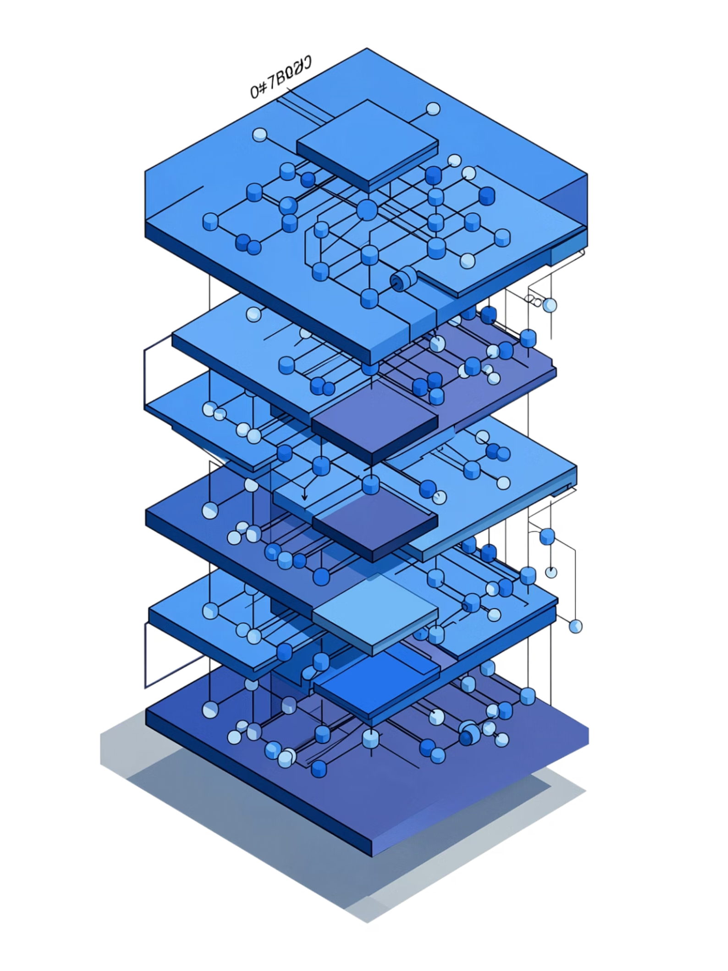

ARCHITECTURE
U-Net Architecture
Encoder
1
Successive convolution blocks extract hierarchical features while progressively reducing spatial resolution via max pooling.
Bottleneck
2
The deepest layer captures the most abstract, high-level semantic patterns across the entire image.
Decoder
3
Transposed convolutions progressively upsample feature maps, reconstructing the full-resolution segmentation mask.
Skip Connections
4
Concatenate encoder feature maps directly into the decoder, preserving fine-grained edge and texture information.
~31 Million Parameters — trained end-to-end from random initialization on the full car dataset.

Slide 8
TRAINING
Training Process & Hyperparameters
Optimization Strategy
Hardware Efficiency
A carefully tuned training configuration balances convergence speed, mask accuracy, and GPU efficiency throughout the training run.
GPU Training
Mixed Precision FP16
Batch size tuned to maximize GPU memory utilization
Cuts memory footprint by ~50%, enabling larger batch sizes and faster throughput
Loss Function
Optimizer
Learning Rate
Dice + BCE Combined — Dice penalizes shape mismatch; Binary Cross-Entropy enforces pixel-level accuracy.
Adam with Weight Decay — adaptive learning rates per parameter with regularization to prevent overfitting.
Adaptive Schedule — automatically reduces learning rate when validation loss plateaus.

Slide 9


RESULTS
Results & Evaluation Metrics
87.54%
78.13%
Dice Score
IoU Score
Measures overlap between predicted and ground-truth masks
Intersection over Union — strict overlap ratio
What These Metrics Mean
Visual Quality
Dice Score: Harmonic mean of precision and recall — how well the predicted mask aligns with the ground truth
IoU: Ratio of the intersection to the union of prediction and label — the standard segmentation benchmark
Clean, sharp edges along vehicle contours
Robust handling of shadows and reflective surfaces
Exports as transparent PNG — production-ready output

Slide 10
GrabCut vs. U-Net: Choosing the Right Segmentation Method
A side-by-side comparison of two leading image segmentation approaches — evaluated for speed, accuracy, and production readiness.
Feature
GrabCut
U-Net
Speed
Fast (CPU)
Fast (GPU)
Accuracy
~60–70%
87.54% Dice
Complex Backgrounds
Struggles
Handles well
Setup
No training required
Requires training
Best For
Quick edits
Professional use

Slide 11
Real-World Applications & Future Work
Where It's Being Used Today
What's Next
01
E-Commerce & Car Listings
Video Background Removal
Clean background removal boosts product imagery quality and conversion rates.
Extend segmentation to temporal sequences for real-time video workflows.
Automotive Marketing & AR
02
Precise vehicle segmentation enables immersive augmented reality experiences.
Glass & Reflection Handling
Improve robustness on transparent and reflective surfaces — a known edge case.
Insurance & Damage Assessment
03
Automated segmentation accelerates claims processing and damage evaluation.
Web App or API Deployment
Package the model into an accessible endpoint for seamless integration.

Slide 12

CONCLUSION
Key Takeaways
Deep Learning Wins
Strong Metrics
Production Ready
U-Net significantly outperforms classical GrabCut in handling real-world complexity and fine detail preservation.
87.54% Dice / 78.13% IoU achieved from scratch — no pretrained models or external datasets.
Clean transparent PNG exports suitable for e-commerce, advertising, and automotive pipelines.
The project demonstrates that a carefully designed U-Net trained from scratch, with proper data preprocessing and a combined Dice+BCE loss, delivers high-quality automotive segmentation competitive with industry standards.

Slide 13
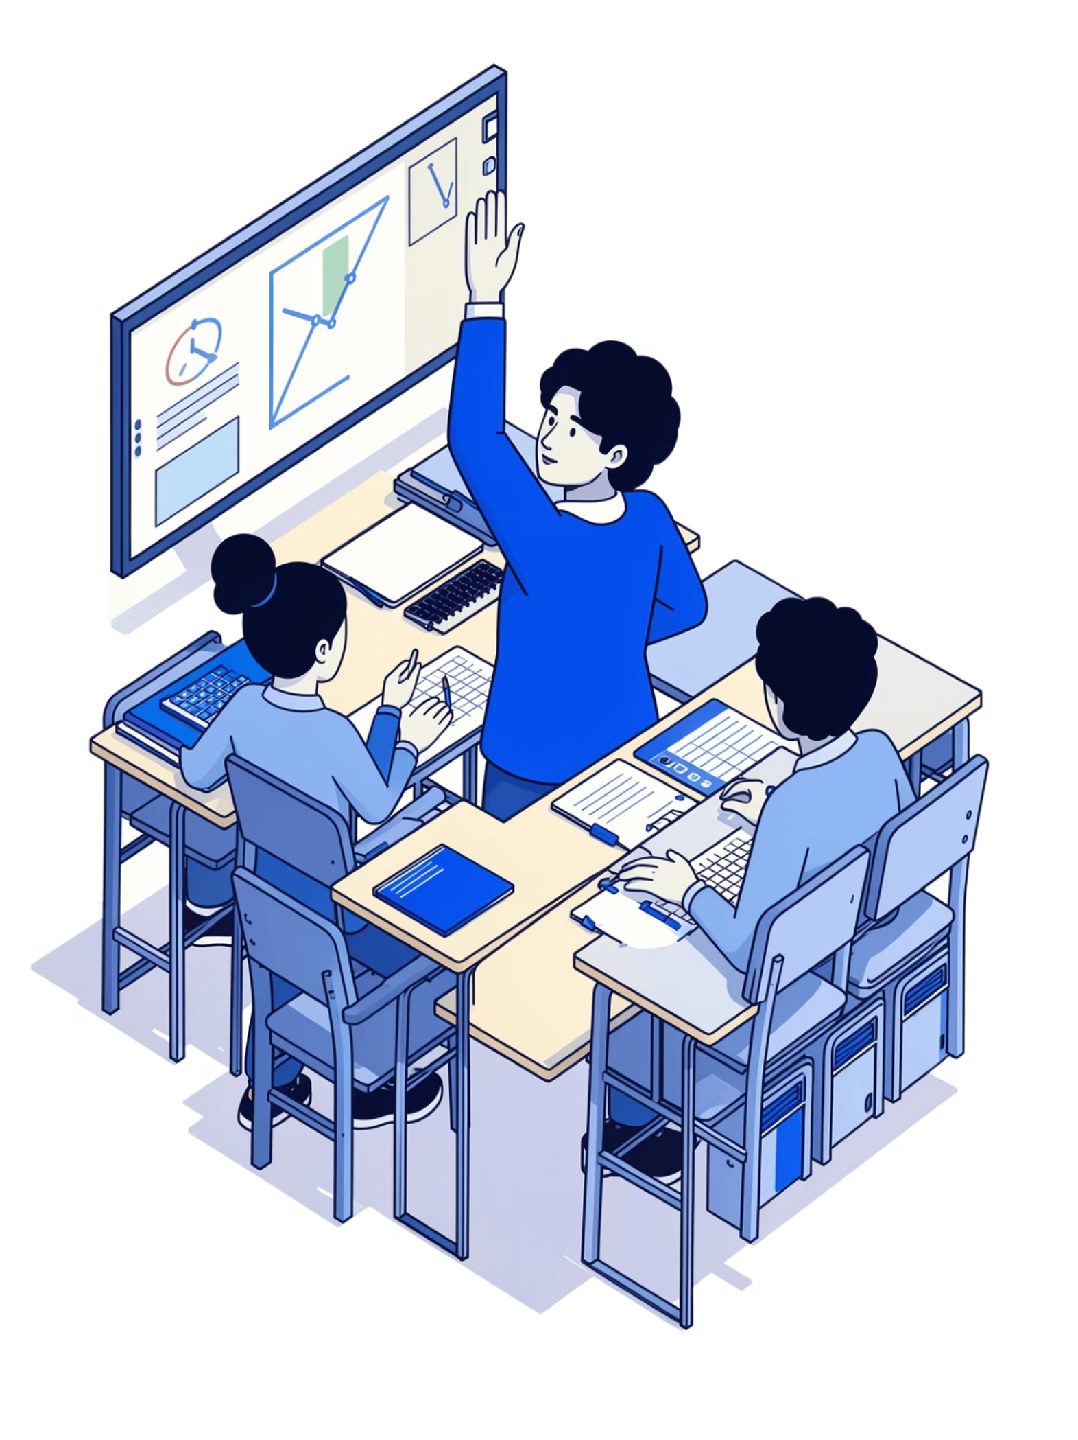
Any Questions?
Now's the time — open the floor for discussion, feedback, or deep dives into any aspect of the segmentation pipeline.

Slide 14

Thank You
We appreciate your time and attention. Reach out to continue the conversation.

